Slide 1
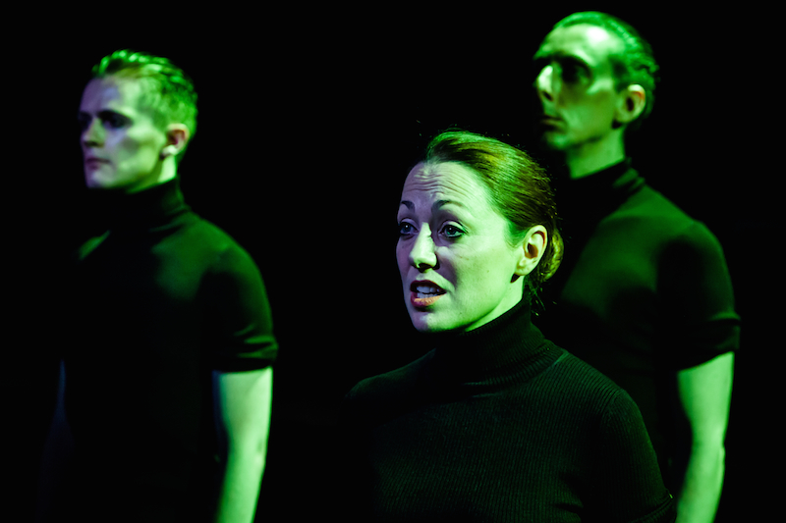
Camera Lucida* – Miranda floy
*loo-see-duh

Slide 2
Moment 1 – Erratic Typing
Was done with fast, rigid hand movements to make as much noise as she could.
Clearly wasn’t typing anything by this point which showed the disarray in the atmosphere.
As an audience, we find this very eerie – her facial language was connoting a much calmer state that her body language was, almost as if she wasn’t in control of her hands.

Slide 3
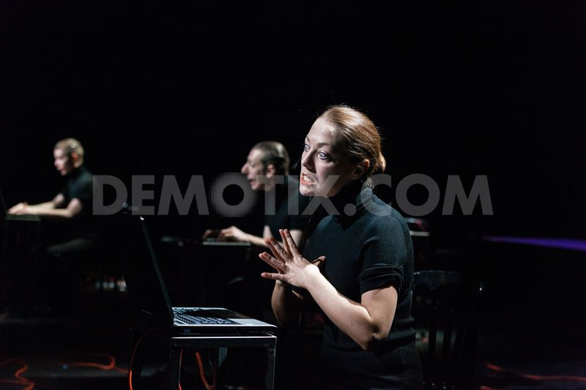
Moment 2 - Possession
Early in the play, Floy rolls her eyes towards the back of her head whilst she writhed and twitched violently in her seat, showing that she had been possessed by the spirit inside her computer.
As Floy was not centre stage, this exaggerated twitching drew the audiences attention to her.
As an audience we felt alienated by Floy and uneasy – her demonic eyes and violent shaking and jerking of her limbs told us Floy’s character was experiencing the ‘downloading’ of a spirit.

Slide 4
Moment 3 – Movement from laptop to laptop
When moving from laptop to laptop, we were given the impression that the actors were ghosts in purgatory.
Whilst doing this, Floy’s upper body was very rigid. The direction that she was moving in was very direct, however her pace was slow, and she shuffled her feet around the stage, as if gliding like a ghost.
As an audience, we would feel disconnected from the real world, like the ghosts as they were literally disconnected and searching for a computer to embody.

Slide 5
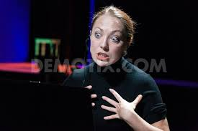
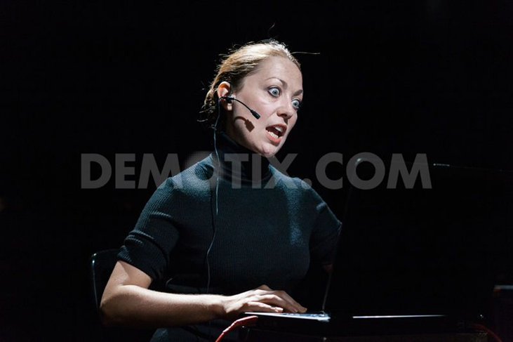
Moment 4 – Stereotypical American ‘Mom’
For the audience, this was a moment of comic relief to break the tense atmosphere.
She had a very ditzy character, which was shown through her voice – using the playback technique coined by Beau, Floy bought it to life with subtle mannerisms, like stuttering at the right moments. Her facial expressions were exaggerated, i.e. wide eyes/mouth to show the annunciation of her words. She also matched body gestures perfectly with this like a flick of a hand when she was struggling to find the words to speak.

