Slide 1
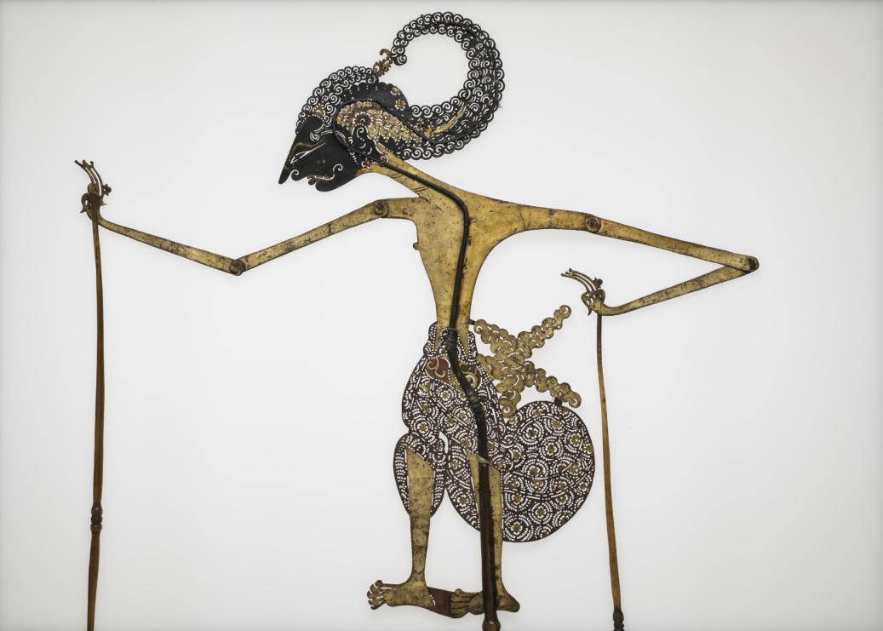
Egyptian Shadow Puppet Theatre
By Joshua Stringer

Slide 2
Origins
Shadow puppets reached Egypt through India, which in turn got them from China.
They were brought to Egypt when Mohammed ibn Daniyal wrote three shadow plays
It differs from Turkish Karagoz shadow puppetry because it has no fixed characters. It also uses different plays and puppets

Slide 3
Style
It was performed to rowdy coffeehouses in uneducated villagers and children.
The puppets were made from rawhide that had been painted with bright colours.
Due to Islamic law the puppets had holes in their chest and stomach.
Each puppet possessed articulated limbs which were attached to a long stick allowing the Muqaddam or puppet master to control them.
The shadows of these puppets where then projected onto a white screen for the audience to view.

Slide 4
The scripts
The plays were written in verse.
A Muqaddam would often get his students to help him with a performance.
They were sung or spoken quite loudly, in crude Arabic, to compensate for the loudness of the coffeehouse.

Slide 5
Effect on me
Egyptian shadow theatre have shadow theatre has shown me just how far reaching shadow puppets were.

