Slide 1
Stanislavski’s system
An explanation

Slide 2
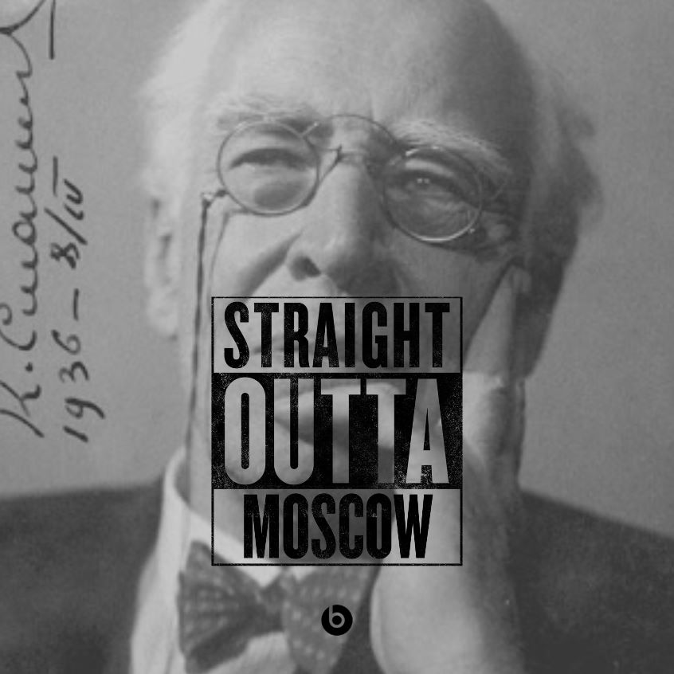

Slide 3
So… What’s this Stan bloke all about?
(style) Naturalism- appearing to present reality on stage
Using past experience and imagination to create real emotions and real moments on stage
This is as opposed the more melodramatic/ exaggerated comedic/ tragic acting of the time.

Slide 4
Konstantin Stanislavski
Born in Moscow, Russia in 1863.
An actor and moved on to become a director and teacher.
He developed a new approach to acting.
It took years of experimenting to get to what is now known as the Stanislavski System.

Slide 5
Stanislavski's System
As an actor, Stanislavski saw a lot of bad acting - what he termed as artificial. Stanislavsky wanted actors to work on characters from the inside (instead of the outside) and thus create more of a "true" or "real" (i.e. not artificial) performance.
Stanislavski's thought process toward acting differed greatly from the way actors traditionally approached their roles.

Slide 6
What is it?
The Stanislavski System is an intense character development process that strives to make a performance "real" and not artificial
1. Bring an actor's experiences into the role.
2. Expand an actor's imagination.

Slide 7
The scene…
Through improvisation, create the following scene-
The scene takes place over breakfast, both of you share a house and the night before something happened that strained your relationship. Do not refer to this directly, just play out the tension and try to show a relationship.

Slide 8
Motivation
In order to give scenes more depth and challenge actors to flesh out their roles, Stanislavski felt actors needed to define their characters motives.
This was done by creating Given Circumstances and using these to decide on a character’s objective and super objective.

Slide 9
Given Circumstances- the total set of environmental and situational conditions which influence the actions that a character in a drama undertakes. Although a character may make such choices unconsciously, the actor playing the character is aware of such conditions on a conscious level to help him or her deepen his or her understanding of the motivation behind the character's actions.

Slide 10
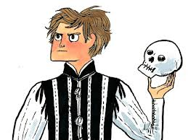
Motivation
The Objective is what a character wants to achieve when they enter a scene.
The Super Objective
is what a character
is aiming to achieve
over the course of
the whole play.
What’s my motivation?

Slide 11
subtext
Create some Given Circumstances by answering these questions-
What is the characters’ relationship? Friends? Colleagues? Acquaintances? Don’t really like each other? Ex partners?
Where are you? Someone’s house? A public place?
How did person B get the diary? Was it genuinely lost or did they take it?
Will either revelation come out (sibling fancying/ diary reading)

Slide 12
Unit
A Unit of action- is a technique used by actors to split scenes up, each time their objective changes- a new unit is created.
In the scene there is bound to be a change in objectives, because one of the revelations comes out- at this point, finding/ hiding the diary will no longer be the character’s main objective.

Slide 13
Subtext
How is the acting using their acting skills to reveal some of their subtext?
Or
What is the character’s subtext and how is their acting showing this?

Slide 14
Inner and Outer Rhythms
This is a process where a person is outwardly moving at a different pace to how they are inwardly moving.
A liar, may appear calm on the outside but is panicked on the inside.
Conversely, Usain Bolt is moving exceptionally fast, but inside is very calm.
Though little mannerisms, the skilled actor lets the inner rhythm show- through breathing, moving the eyes, tapping etc.

