Slide 1
Tybalt line…
Consider where your audience are, they all need to engage with you.
Take a moment to remember how you were going to deliver it.
Please don’t clap everyone we will be here all day!
Write your target by no. 1 on page 15_ of planner.

Slide 2
Types of Theatre Stage

Slide 3
Label your stage with the following
Upstage
Downstage
Stage left
Stage Right
Wings
Centre Stage
Apron

Slide 4
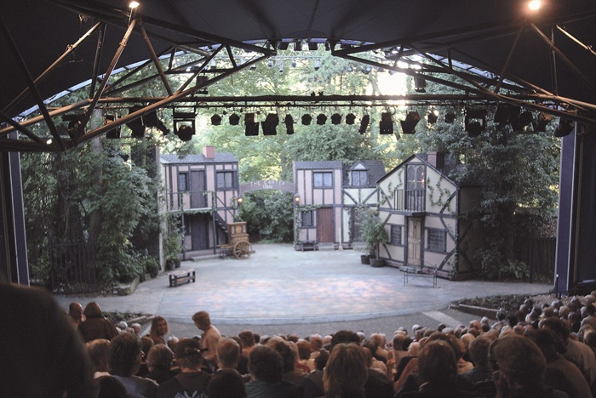
wings
wings
Upstage
x
Stage left
Stage Right
Downstage
this is the Apron

Slide 5
There are many different types of theatre stage.
The 5 most common theatre spaces are;
Proscenium Arch/ End on
Thrust Stage
Theatre in The Round
Traverse Stage
Promenade Theatre

Slide 6
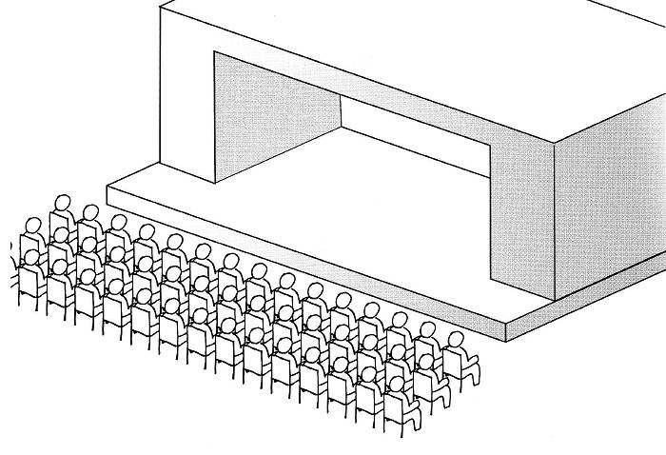
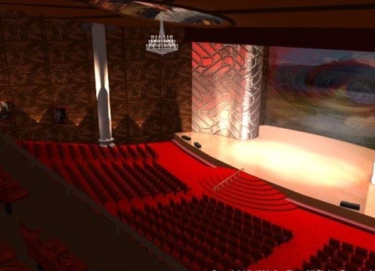
Proscenium Arch/ End on
Most theatre spaces are Proscenium Arch
The stage is like a room with the forth wall removed.
All the action takes place in front of the audience, who are deliberately kept outside of the action
The name comes from the frame at the front of the traditional stage.
This would be the sort of staging you are used to doing in the Drama room
Actors need to pretty much face forwards the whole time and use a big voice

Slide 7
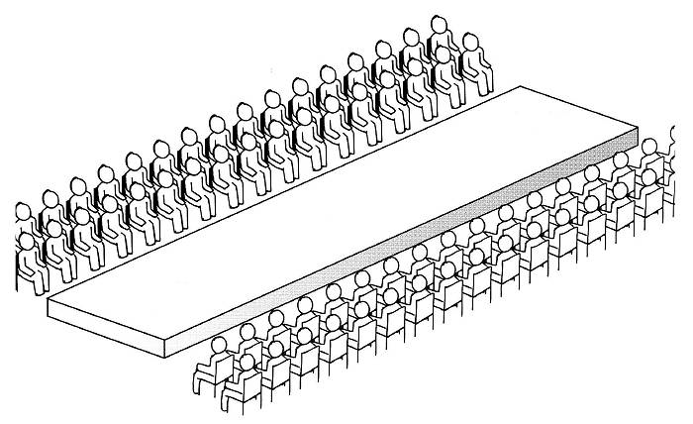
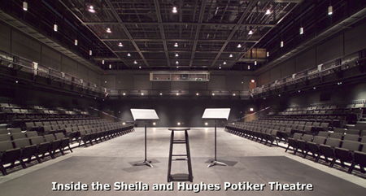
Traverse Stage
The Audience is on 2 sides of the actors.
This is really good for duologue, as the audience can really see the distance between characters
High levels and set need to be at either end of the stage.
Movements need to be big, as some audience members will not be able to see you very clearly.
This also works very well for asides and soliloquies as the audience are usually very close and naturally some are on your side (literally)

Slide 8
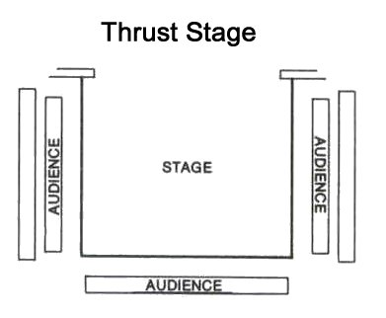
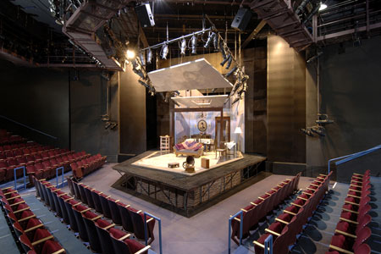
Thrust Stage
Apron extends into the audience on three sides
More intimate than a Proscenium Arch.
Because you will almost always have your back to one part of the audience you have to be constantly moving, so that all the audience see your acting.
You can use the closeness of the audience for asides or soliloquies. – this is great for doing Shakespeare!
Standing Upstage in the middle of the stage is known as the Power Position and is where the character with the highest status should be.
X
Power position

Slide 9
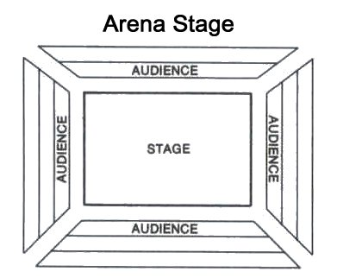
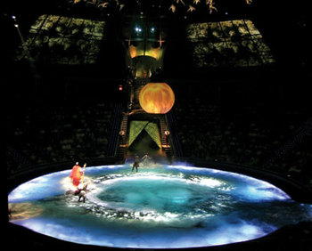
Theatre in The Round
Theatre in the Round, is when the audience sit all around the stage.
The stage is not necessarily round
High levels need to be in the centre of the stage
As with Thrust Stage: Constantly moving and need to use voice well so that audience can hear you.
Your reaction to other actors is vital because half the audience won’t be able to see your face.

Slide 10
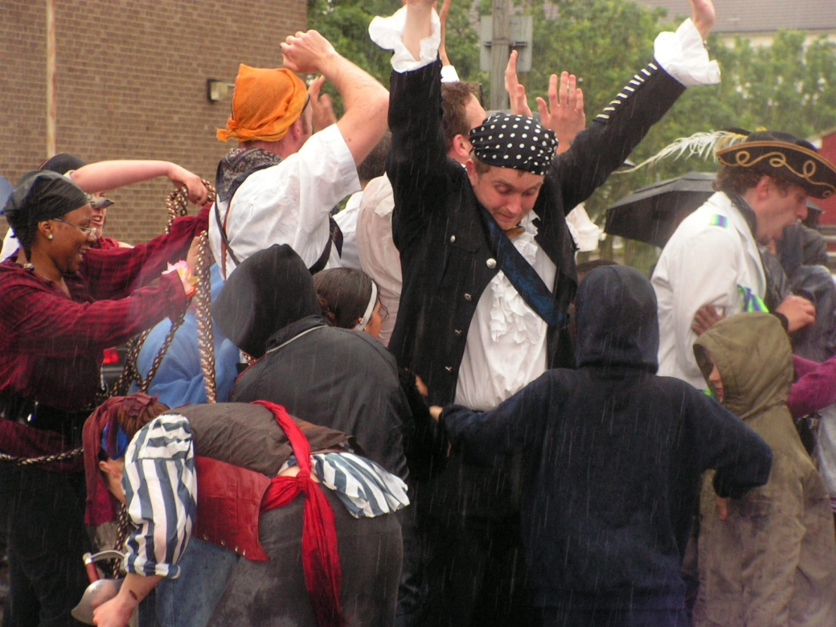
Promenade Theatre
Promenade Theatre is when there is no divide between the actors and the audience
Actors can enter from anywhere and perform anywhere
This creates a realistic and intimate atmosphere for an audience because they are all within the performance.
Often audience will have to follow actors around a large space, this frees up actors to make the most of the space and even interact with the audience.
A few years ago, when we did Romeo and Juliet at BGS the opening fight scene took place within the audience- why do you think this was effective

Slide 11
Homework
Create a PowerPoint/ poster of the 5 types of staging. You can email this in if you wish otley_h@bexleygs.co.uk, brazier_h@bexleygs.co.uk, bartlett_p@bexleygs.co.uk or palmer_c@bexleygs.co.uk
Proscenium Arch/ End on
Thrust Stage
Theatre in The Round
Traverse Stage
Promenade Theatre
This should contain-
The amount of sides the audience are on
How it effects the staging
How it effects the acting
4. Where could this style of staging work best in Romeo and Juliet?

Slide 12
Applying this knowledge
You will shortly be put into 6 groups, each group will be portraying the party scene using a different type of staging.
Events in the scene
1. Capulet makes a big speech to welcome guests
2. Romeo and Benvolio crash the party.
3. Romeo and Juliet meet and fall in love
4. Tybalt sees Romeo and wants to have a fight.
This will be your first assessment of the year! So make it good. (we’ll watch the ALL next week)

Slide 13
Characters at the Party
To help you with the scene, these are the main characters in the scene, consider there reason for being at the party and what happened to them there.
Romeo
Juliet
Capulet
Paris
Tybalt
Benvolio
Nurse
Servants
Lady Capulet
Mercutio

Slide 14
Plenary
Consider in your group how the different staging will effect your acting.
I will pick someone from each group, so you need to all have an answer ready.

